Slide 1
Project title – Hiring Process Analytics
Project Description :-
Hiring process is the fundamental and the most important function of a company. Here in this project we get to learn about the hiring trends of the company and draw insights from them.
A brief description of the case study and output required is given below :-
How many males and females are Hired ?
What is the average salary offered in this company ?
Draw the class intervals for salary in the company ?
Draw Pie Chart / Bar Graph ( or any other graph ) to show proportion of people working different department ?
Represent different post tiers using chart/graph?

Slide 2
Approach –
We have got datasets which contains tables that contain information regarding various fields related to company hiring data. We went through the dataset closely and then executed various queries to extract the required data from the table.
Tech/Tools used –
We used below mentioned tools to perform the analysis :-
PPT – To prepare a detailed report on the observations based on the data received.
EXCEL – Excel was used to perform entire analysis and the questions asked were answered.

Slide 3
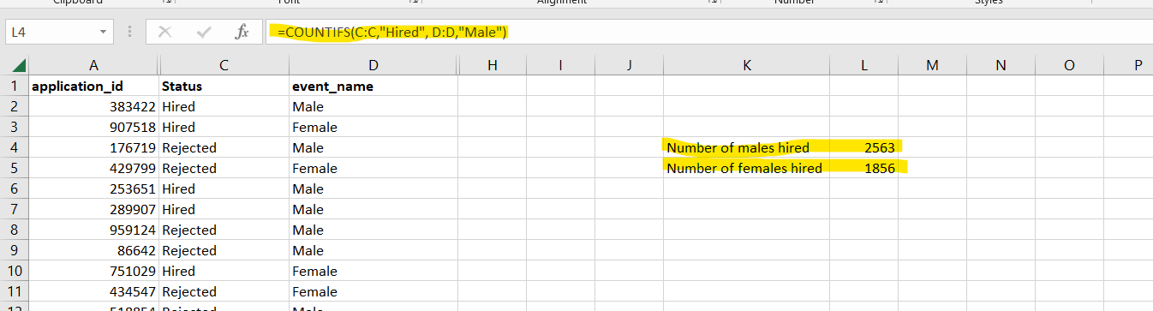
1. How many males and females are Hired ?
The formula used in excel was as follows :-
COUNTIFS(C:C,"Hired", D:D,"Male")
COUNTIFS(C:C,"Hired", D:D,“Female")

Slide 4
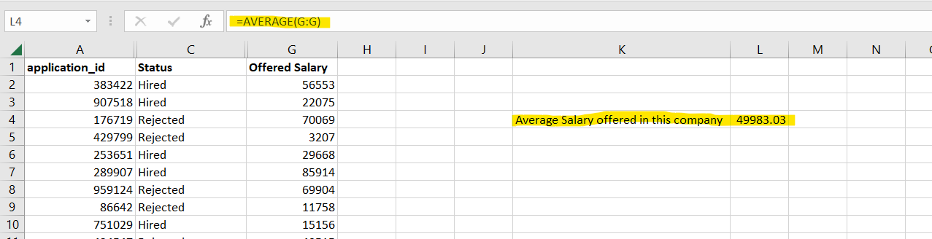
2. What is the average salary offered in this company ?

Slide 5
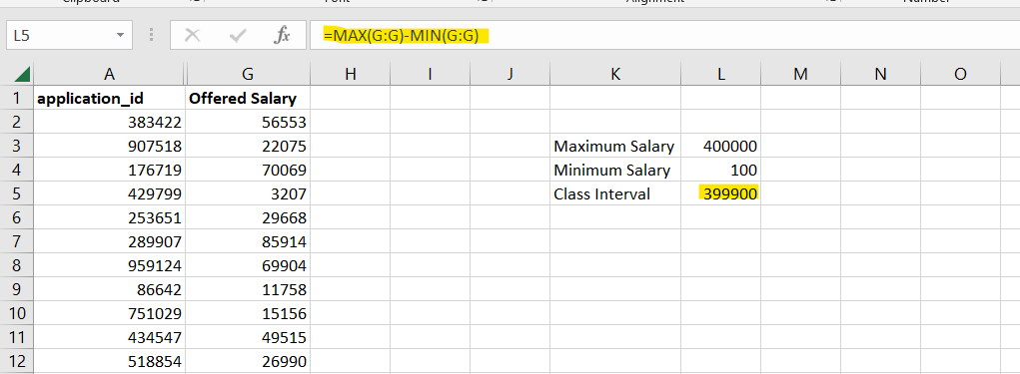
3. Draw the class intervals for salary in the company ?

Slide 6
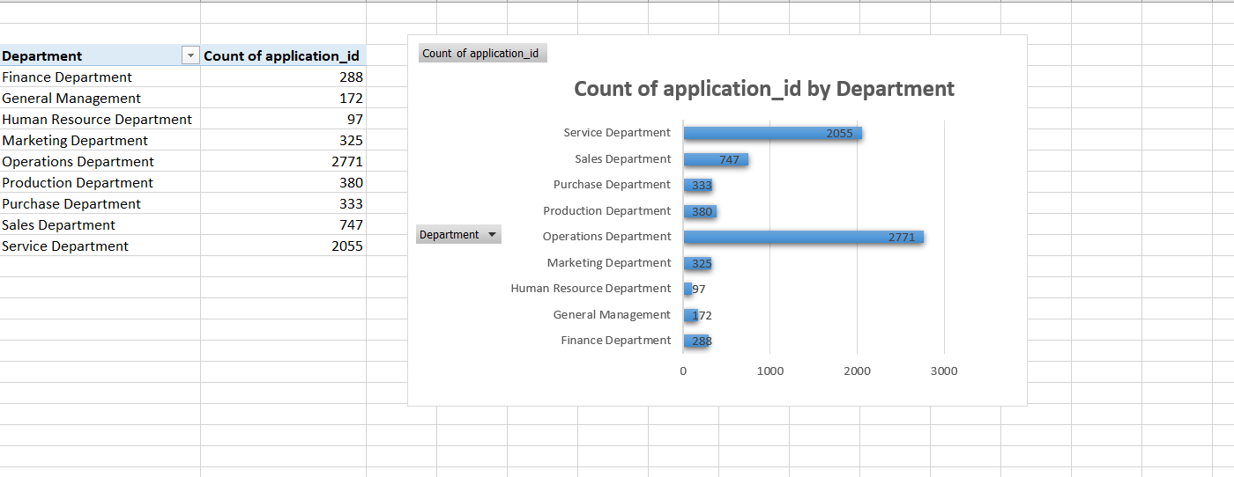
4. Draw Pie Chart / Bar Graph ( or any other graph ) to show proportion of people working different department ?

Slide 7
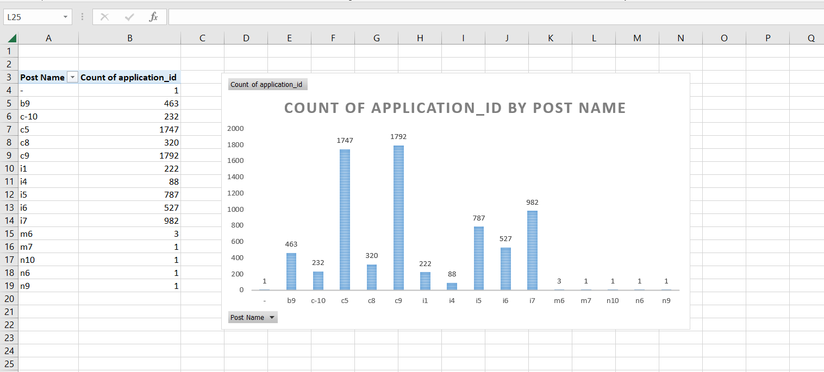
5. Represent different post tiers using chart/graph?

Slide 8
RESULTS :-
All the results obtained are shown in screenshots in previous slides.
All complete values/data obtained after queries are present in excel attached below .

